Slide 5
Gap Identification
Base paper uses ResNet18 with single-stage transfer learning on a general dataset, achieving 96% accuracy.
Limitations include the use of a generalized dataset and single-stage transfer learning.
A more specific dataset and multi-stage transfer learning may enhance fine-tuning and feature extraction.
Gap exists in surpassing the 96% accuracy by improving model performance and generalizability.
Proposed solution: 2-stage transfer learning with ResNet50, training on a large general dataset, then fine-tuning on a specific Plant Village dataset.
Aim is to push beyond 96% accuracy for better plant disease classification in precision agriculture.

Slide 6
Project Plan
Research focuses on automated plant disease classification using a two-stage transfer learning method with ResNet-50.
First stage pre-trains ResNet-50 on a 25 GB dataset of diverse leaf images to learn generalizable features.
Second stage fine-tunes Model A on the Plant Village dataset for specialized disease recognition.
Dataset preprocessing includes advanced augmentation, intelligent shuffling, efficient caching, and optimized batching with TensorFlow's tf.data API.
Model A should achieve a 95% accuracy on the 25 GB dataset, anticipating further improvement through fine-tuning.
Key contributions: two-stage transfer learning, enhanced model generalization, efficient data handling pipeline, high first-stage accuracy.Model supports flexible GPU/TPU usage, ensuring efficient training and deployment in various environments.

Slide 7
ResNet-50 Overview:
ResNet-50 is a convolutional neural network with 50 layers, widely used for deep learning tasks due to its architecture.
Feature Learning: The network excels at learning hierarchical features from images, making it highly effective for recognizing visual patterns crucial in diagnosing plant diseases from images.
Transfer Learning Capability: ResNet-50, pretrained on large datasets like ImageNet, can be fine-tuned with smaller domain-specific datasets (e.g., plant diseases), reducing the need for extensive data and computational resources.
High Accuracy: The deep architecture allows it to achieve high levels of accuracy in image classification tasks, essential for reliable and precise plant disease identification.
Speed and Efficiency: ResNet-50’s ability to train relatively quickly and perform inference efficiently makes it suitable for deployment in real-time plant disease monitoring systems.

Slide 8
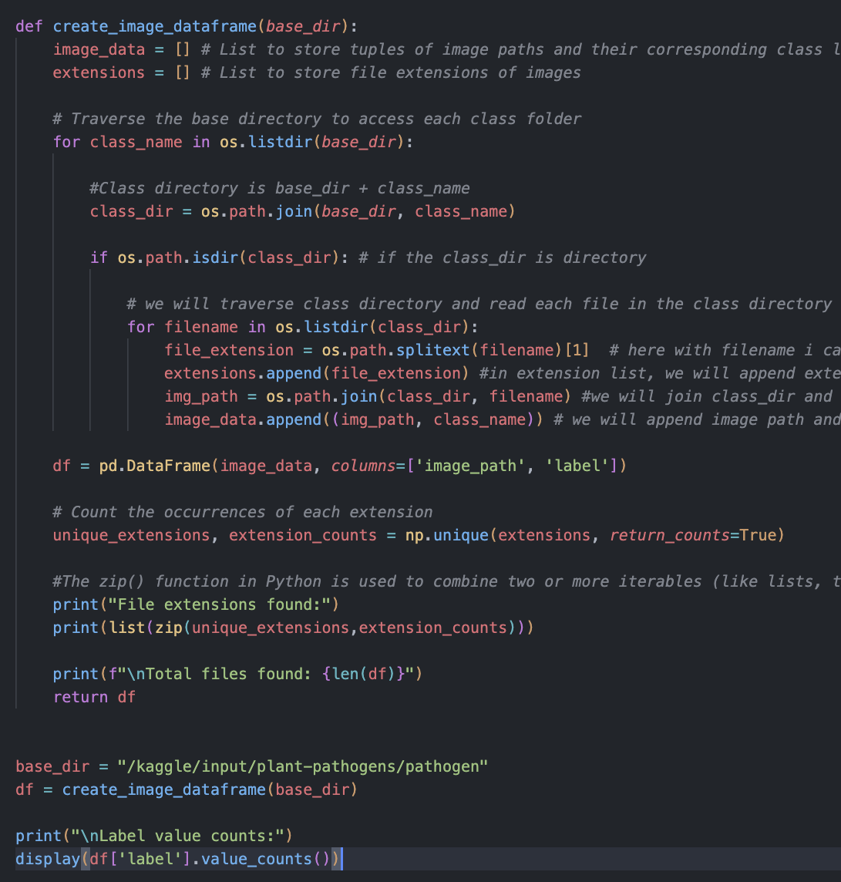
IMPLEMENTATION
create_image_dataframe()` function performs following operation
Traverse dataset (`base = '/kaggle/input/plant-pathogens/pathogen'`) directory
Gets class directory (ie `base` + bacteria,fungus,healthy,pest,virus) directory
Traverse each image in `class` directory and
Get full path of image by `full_path = base + class + imgpath`
Create a list of `full_path`, `class`
Append it in list `image_data`
Add extension of image in `extensions` list
print unique extensions and number of unique extension using `extensions` list.
Create pandas datafame `df` using `image_data` list and rename column to `img_path` and `label`.
Return dataframe

Slide 9
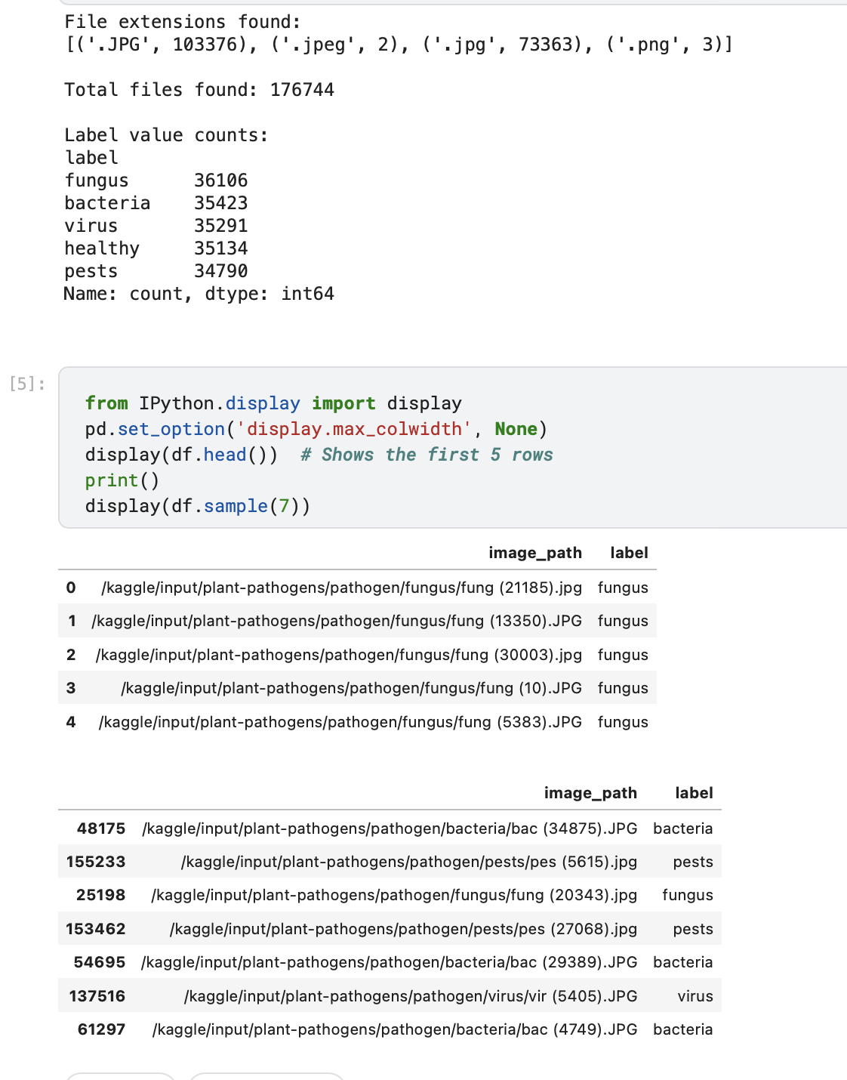

Slide 10
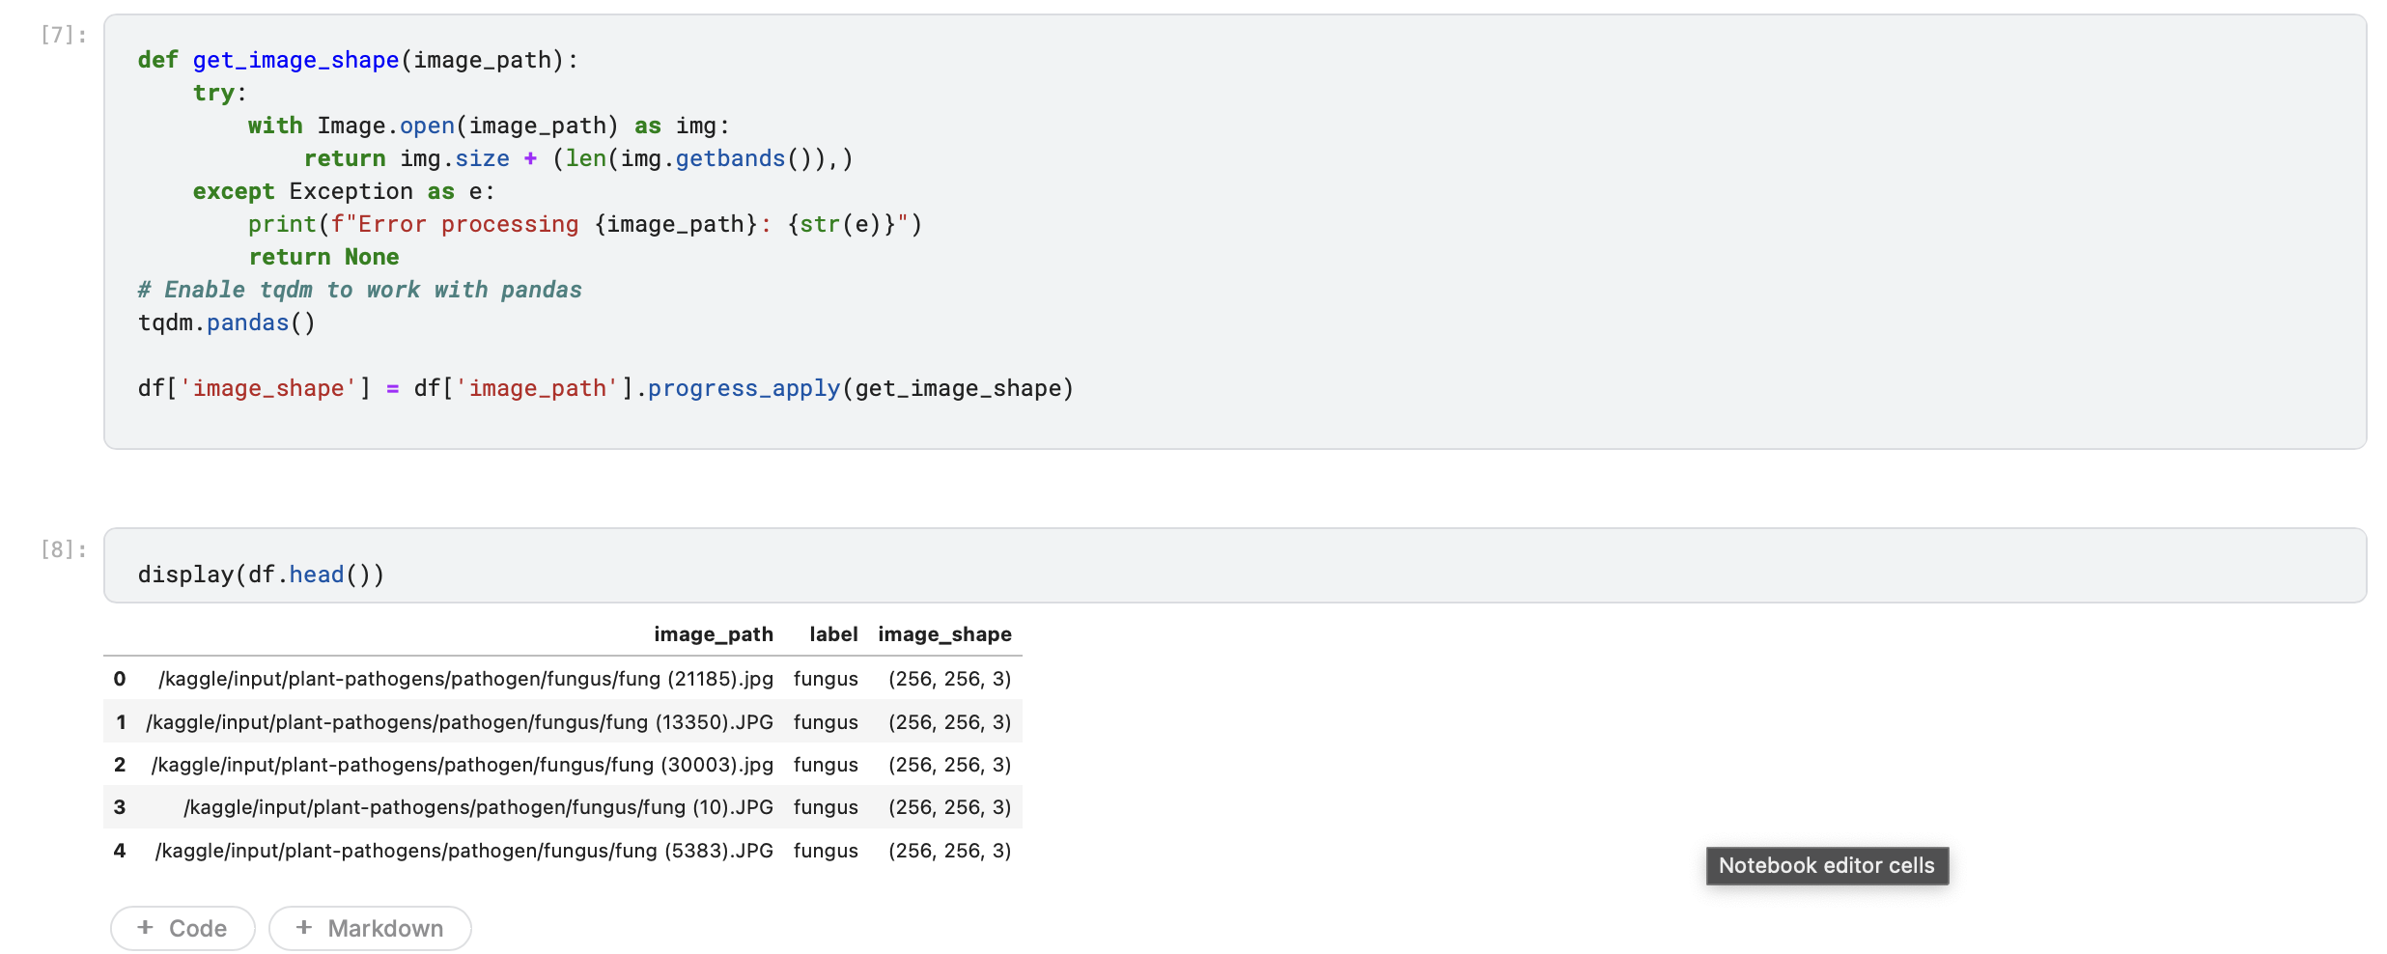
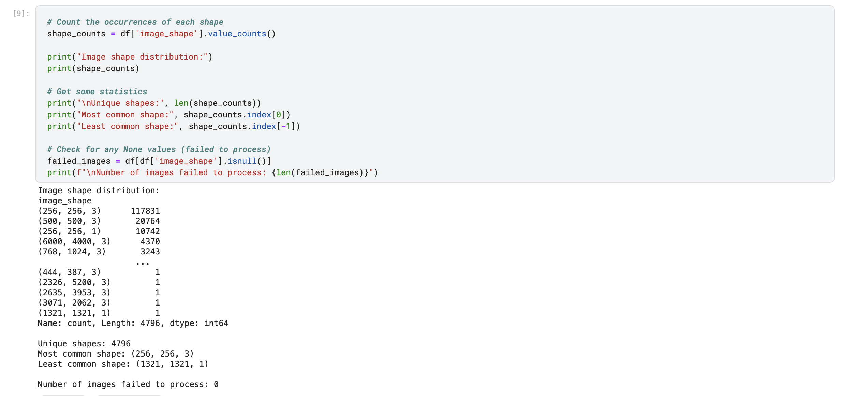
Image shape
This code is used to determine the shape of images in a dataset. It defines a function `get_image_shape` that takes an image path as input and returns the shape of the image. The function uses the Python Imaging Library (PIL) to open the image and get its size and number of channels. If there is an error processing the image, the function prints an error message and returns `None`.
The code then uses the `tqdm` library to display a progress bar when applying the `get_image_shape` function to each row of a DataFrame `df`. The results are stored in a new column `image_shape` of the DataFrame.
> Here with exception handling, the functions basically returns size + number of color channels in form of

Slide 11
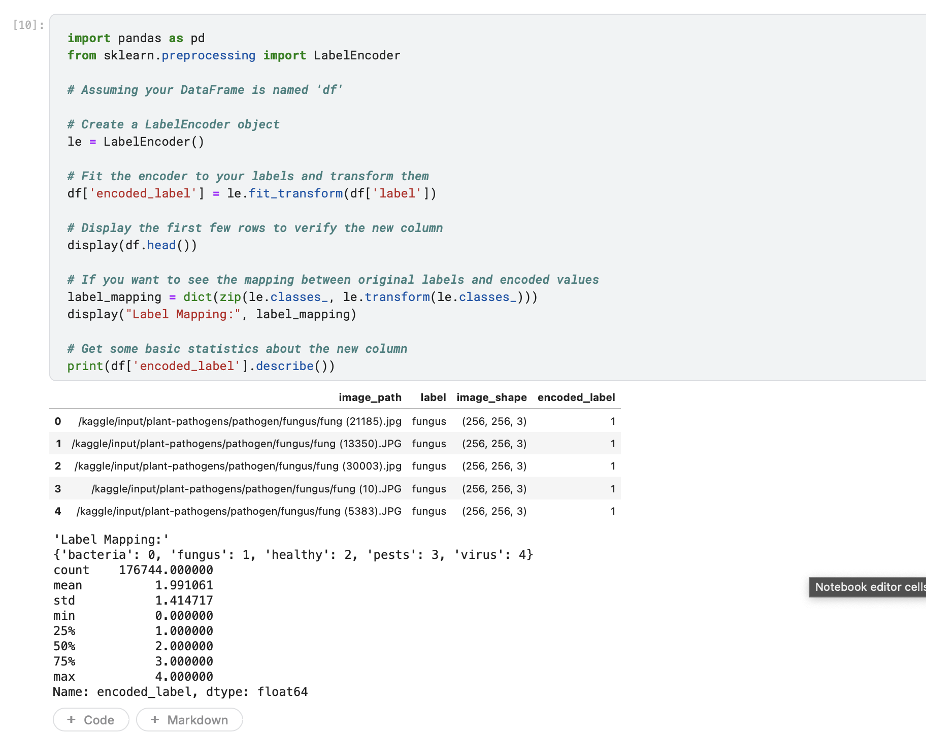
Label Encoding
This code is used to convert categorical labels in a DataFrame into numerical values that can be used for machine learning algorithms. It uses the `LabelEncoder` class from the `sklearn.preprocessing` module to encode the labels.

Slide 12
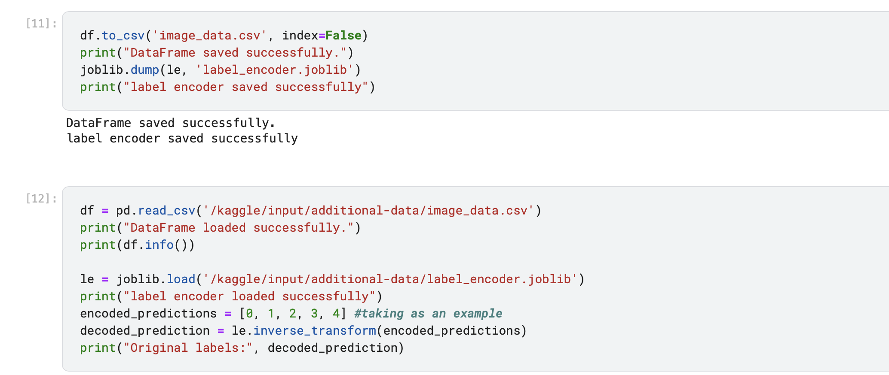

Slide 13
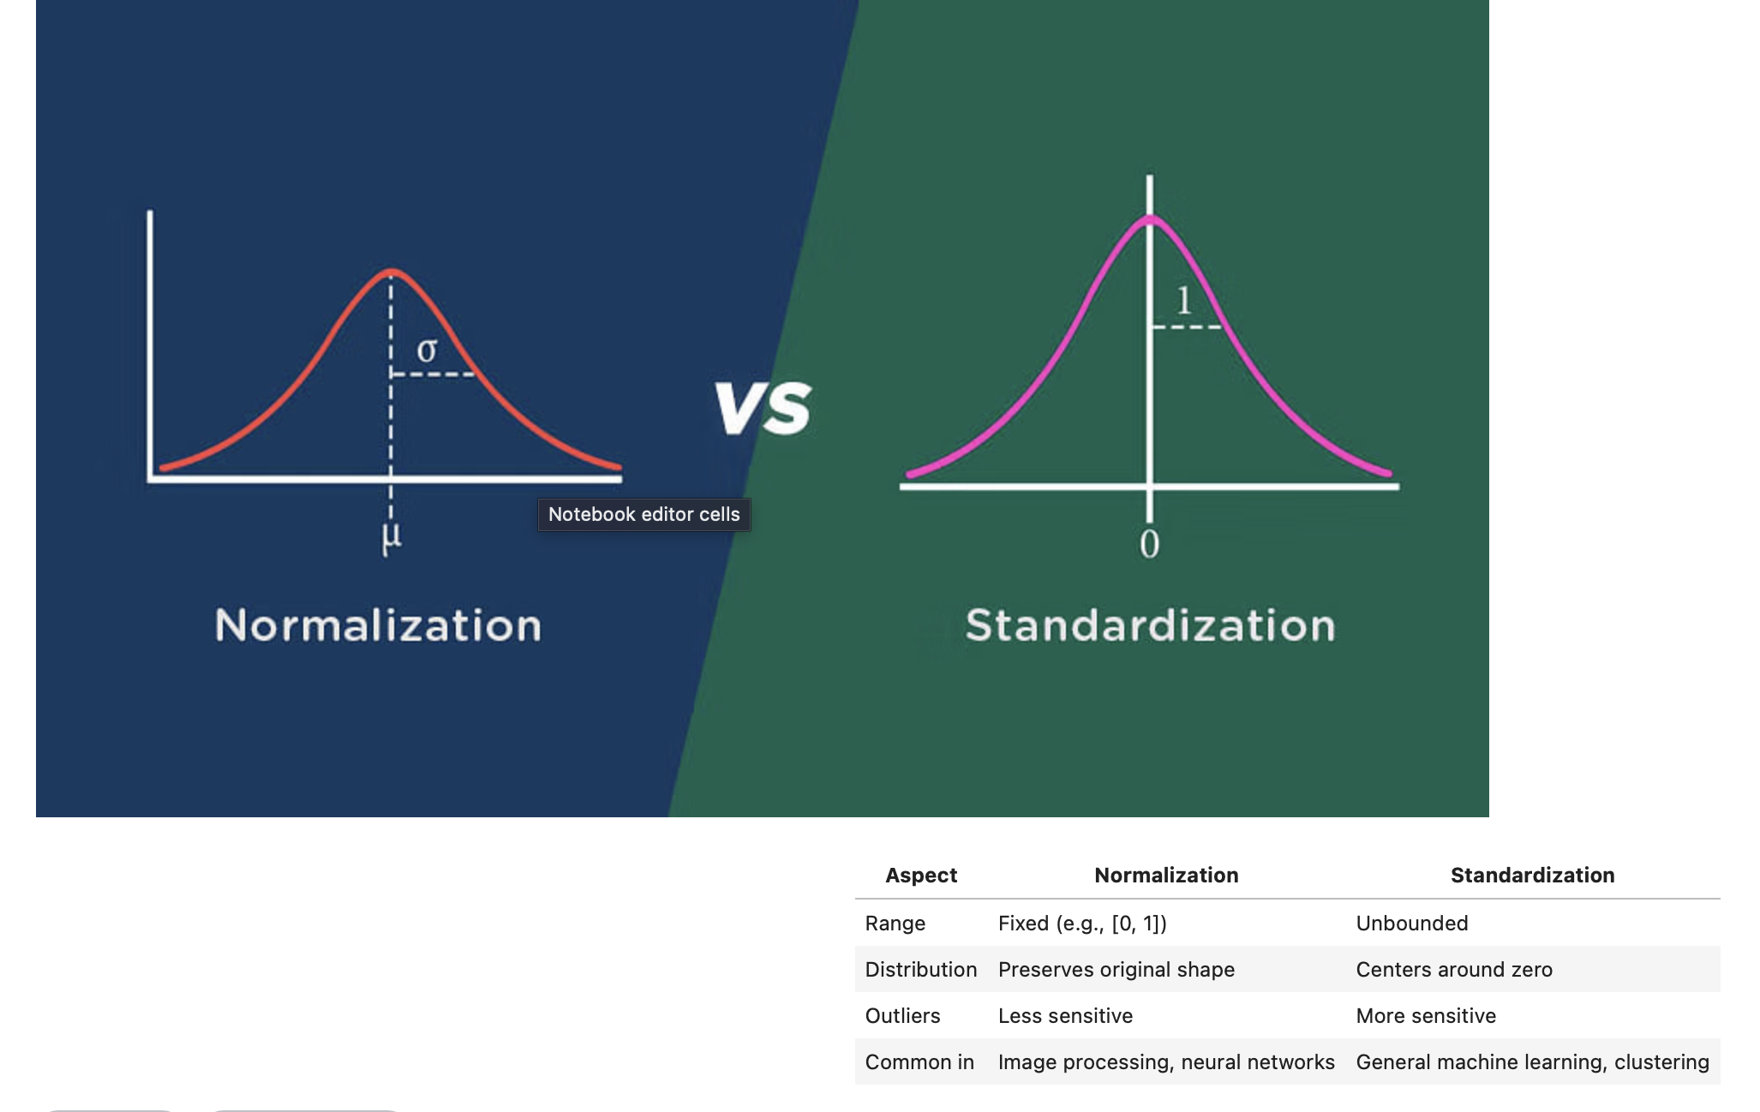
Preprocessing
Normalization scales the values of numeric columns in a dataset to a common range, typically between 0 and 1, without distorting differences in the ranges of values.
Standardization rescales data to have a mean of 0 and a standard deviation of 1, giving the data properties of a standard normal distribution.

Slide 14
Image transformations for Preprocessing
A. Grayscale to RGB conversion
If an image is in grayscale (one color channel), we convert it to RGB (three color channels) using the tf.image.grayscale_to_rgb function. This is important because many models need images in RGB format (red, green, and blue).
B. Check image properties
The check_image_properties function looks at details about the image. It checks the data type, the smallest and largest pixel values, and whether the image uses 8-bit values between 0 and 255.
C. Resize and Standardize image
The resize_and_pad_image function resizes the image to 124x124 pixels using bilinear interpolation with tf.image.resize_with_pad(). It also standardizes the image by adjusting pixel values to have a mean of zero and a standard deviation of one.
D. Normalize the image
Finally, the image is normalized by dividing the pixel values by 255.0 to scale them between 0 and 1.

Slide 15
Pipelining
A TensorFlow pipeline is a structured sequence of operations in TensorFlow used to process and prepare data for machine learning tasks. It automates the workflow of loading, transforming, and feeding data to a machine learning model. The pipeline ensures that data is efficiently handled, from initial loading to preprocessing, augmentation, batching, and shuffling, before being passed to the model for training or inference.

Slide 16
Overview
Efficiently processes image data for machine learning models.
Flexible, scalable, and optimized for speed.
def dataset_pipeline(df, batch_size, target_size, shuffle=True, augment=False, cache=False, temp_dir=None):
df: DataFrame of image paths and labels
batch_size: Number of images per batch
target_size: Final image size after resizing
Optional Parameters: shuffle, augment, cache, temp_dir
Main Steps
Image Generator: Feeds image paths and labels into the pipeline.
Preprocessing: Loads and resizes images to target_size.
Data Augmentation (if enabled): Random image adjustments (flip, brightness, crop).

Slide 17
Steps
Pipeline Steps
Dataset Creation
Uses tf.data.Dataset.from_generator to generate images and labels.
Shuffling (optional): Randomizes data order for better training.
Preprocessing: Resizes and prepares images.
Caching (optional): Stores data in memory or on disk for faster access.
Augmentation (optional): Applies transformations for more varied data.
Batching & Prefetching: Groups data into batches and prefetches for speed.

Slide 18
Key Benefits of the Pipeline
Efficiency: TensorFlow's optimized data processing.
Flexibility: Easy customization with preprocessing and augmentation.
Scalability: Processes large datasets on-the-fly.
Speed: Utilizes shuffling, caching, and prefetching.
Parallel Processing: Multiple tasks handled simultaneously to minimize bottlenecks.

Slide 19
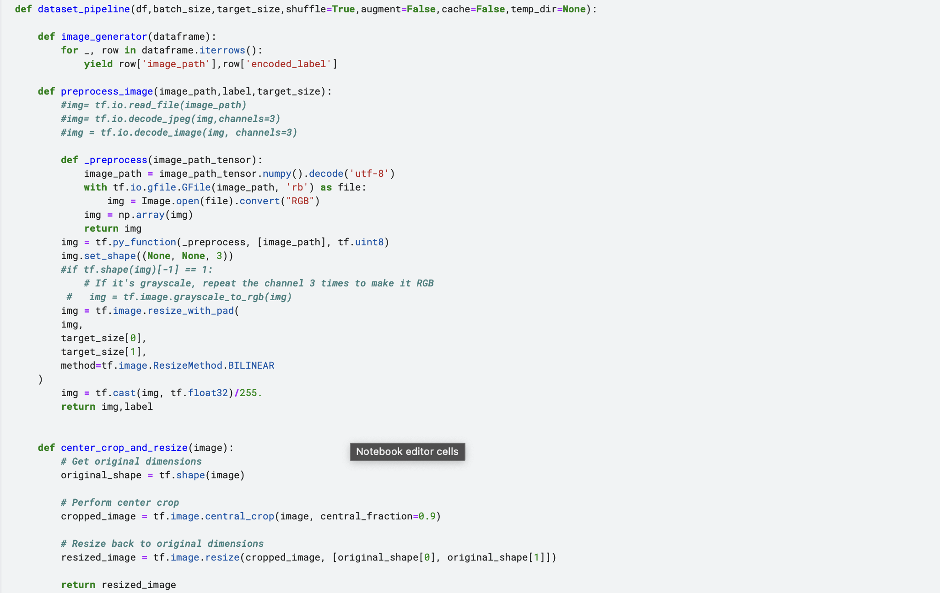

Slide 20
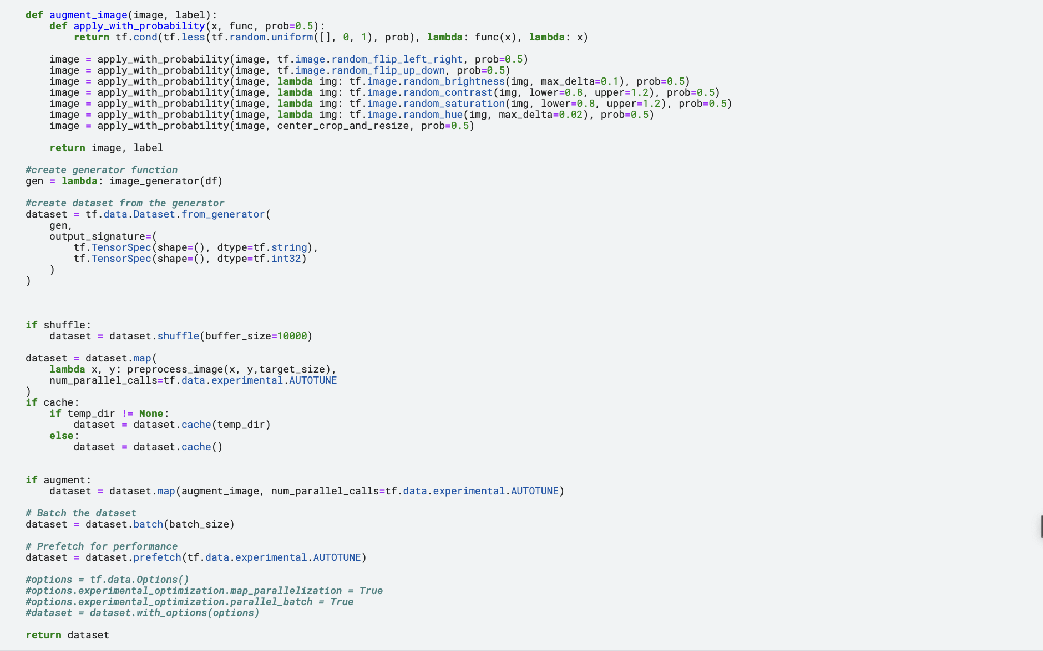

Slide 21
Splitting data into test and training set
Dataset Splitting
Importing Library:
The script starts by importing train_test_split from sklearn.model_selection, which is used to split datasets into training and testing sets.
First Split - Test Set Separation:
train_val_df and test_df are created by splitting the initial dataset (df) into training/validation and test sets using an 85-15% split, ensuring that the test data (test_df) contains 15% of the original data. The split is stratified by the 'encoded_label' to maintain consistent label distribution between splits.
Second Split - Training and Validation Set Separation:
The remaining data (train_val_df) is further split into training (train_df) and development/validation (dev_df) datasets using a 90-10% split. This also uses stratified sampling on the 'encoded_label' to ensure labels are evenly distributed.

Slide 22
Hardware Strategy and Dataset Pipeline Construction
Batch Sizes and Target Image Size:
It sets batch_size_gpu and batch_size_tpu to 128, and target_size for images to (256, 256).
GPU Strategy (if available):
The script checks if GPU devices are available and configures a mirrored strategy for distributed training on GPUs. Datasets are prepared with specified parameters (batch size, target size, shuffling, augmentation, caching) and then distributed using the GPU strategy.
TPU Strategy (if available):
Similar to the GPU setup, if a TPU is available, the script attempts to initialize a TPU strategy. If successful, datasets are similarly prepared and distributed for TPU-based training.
Error Handling for TPU Initialization:
If the TPU initialization fails, an error message is printed indicating that TPU training will be skipped.

Slide 23
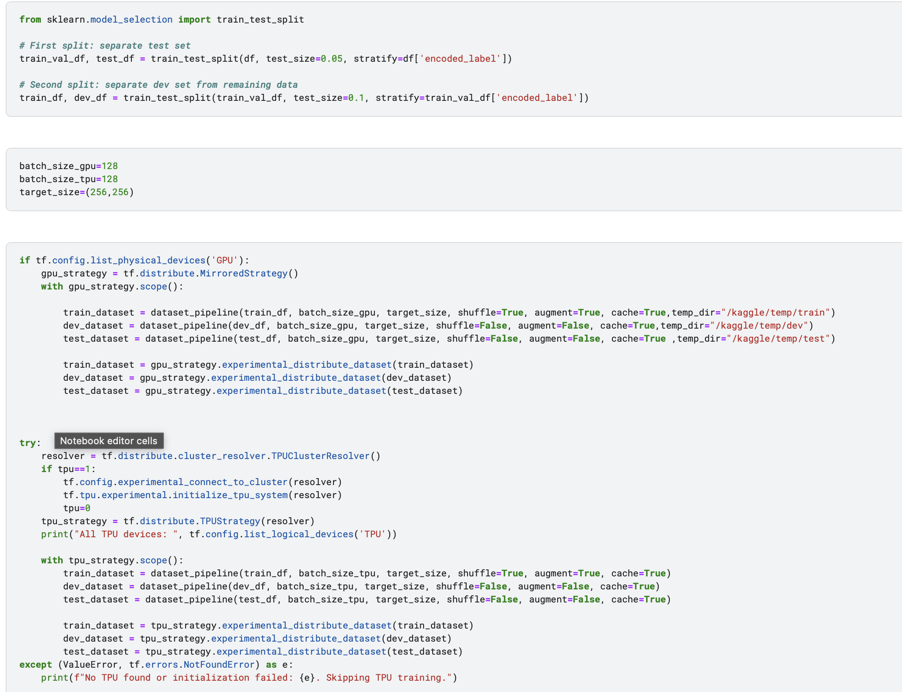

Slide 24
Model Building
Imports and Setup:
Imports TensorFlow and various components from tensorflow.keras, including layers and applications.
ResNet50, Dense, GlobalAveragePooling2D, and Model are notably imported to build and modify the neural network.
Function create_model:
Purpose: Creates a model based on ResNet50 suited for image classification.
Parameters:
target_size: Specifies the input image dimensions expected by the model.
num_classes: Number of output classes for the classification task.
ResNet50 Loading: Loads the ResNet50 architecture without the top layer (i.e., without the fully connected layers typically used for output classification in the original setup), enabling custom layers to be added for specific tasks.
Base Model: ResNet50 loaded with pre-trained ImageNet weights, configured to not include the top layers, and adapted to the target size of the input images.

Slide 25
Adding Custom Layers:
Global Average Pooling: Reduces the spatial dimensions (height and width) of the output from the previous layers to a single 2048-dimensional vector per image.
Output Layer: Adds a dense (fully connected) layer with num_classes neurons, each representing a class score, using a softmax activation function to turn the scores into class probabilities.
Model Compilation:
Optimizer: Uses the Adam optimizer with a learning rate of 0.001 and weight decay, which helps prevent overfitting by penalizing large weights.
Loss Function: Employs sparse categorical crossentropy, which is suitable for multi-class classification tasks where each label is provided as an integer (a common scenario in classification problems).
Metrics: Tracks accuracy, the percentage of images correctly classified.
Hardware Strategy Conditional Execution:
GPU Check: Verifies if a GPU is available and if so, it initializes a mirrored strategy for distributed training, using the custom model creation function within that strategy context.
TPU Check: Similarly, checks for TPU availability and configures the model for training on TPU if available.

Slide 26
